Slide 1



Chapter
2
Descriptive Statistics
© 2012 Pearson Education, Inc.
All rights reserved.
<number> of 149

Slide 2
Chapter Outline
2.3 Measures of Central Tendency
© 2012 Pearson Education, Inc. All rights reserved.
<number> of 149

Slide 3
Section 2.3
Measures of Central Tendency
© 2012 Pearson Education, Inc. All rights reserved.
<number> of 149

Slide 4
Section 2.3 Objectives
Determine the mean, median, and mode of a population and of a sample
Determine the weighted mean of a data set and the mean of a frequency distribution
Describe the shape of a distribution as symmetric, uniform, or skewed and compare the mean and median for each
© 2012 Pearson Education, Inc. All rights reserved.
<number> of 149

Slide 5

Measures of Central Tendency
Measure of central tendency
A value that represents a typical, or central, entry of a data set.
Most common measures of central tendency:
  Mean
  Median
  Mode
© 2012 Pearson Education, Inc. All rights reserved.
<number> of 149

Slide 6
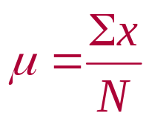
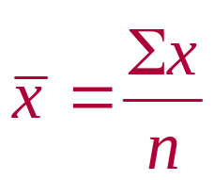
Measure of Central Tendency: Mean
Mean (average)
The sum of all the data entries divided by the number of entries.
Sigma notation: Σx = add all of the data entries (x) in the data set.
Population mean:
Sample mean:
© 2012 Pearson Education, Inc. All rights reserved.
<number> of 149

Slide 7

Example: Finding a Sample Mean
The prices (in dollars) for a sample of round-trip flights from Chicago, Illinois to Cancun, Mexico are listed. What is the mean price of the flights?
872 432 397 427 388 782 397
© 2012 Pearson Education, Inc. All rights reserved.
<number> of 149

Slide 8
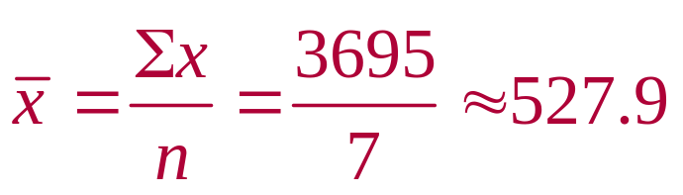
Solution: Finding a Sample Mean
872 432 397 427 388 782 397
The sum of the flight prices is
Σx = 872 + 432 + 397 + 427 + 388 + 782 + 397 = 3695
To find the mean price, divide the sum of the prices by the number of prices in the sample
The mean price of the flights is about $527.90.
© 2012 Pearson Education, Inc. All rights reserved.
<number> of 149

Slide 9
Measure of Central Tendency: Median
Median
The value that lies in the middle of the data when the data set is ordered.
Measures the center of an ordered data set by dividing it into two equal parts.
If the data set has an
  odd number of entries: median is the middle data entry.
  even number of entries: median is the mean of the two middle data entries.
© 2012 Pearson Education, Inc. All rights reserved.
<number> of 149

Slide 10
Example: Finding the Median
The prices (in dollars) for a sample of roundtrip flights from Chicago, Illinois to Cancun, Mexico are listed. Find the median of the flight prices.
872 432 397 427 388 782 397
© 2012 Pearson Education, Inc. All rights reserved.
<number> of 149

Slide 11
Solution: Finding the Median
872 432 397 427 388 782 397
First order the data.
  388 397 397 427 432 782 872
There are seven entries (an odd number), the median is the middle, or fourth, data entry.
The median price of the flights is $427.
© 2012 Pearson Education, Inc. All rights reserved.
<number> of 149

Slide 12
Example: Finding the Median
The flight priced at $432 is no longer available. What is the median price of the remaining flights?
872 397 427 388 782 397
© 2012 Pearson Education, Inc. All rights reserved.
<number> of 149

Slide 13
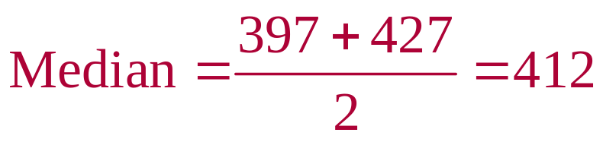
Solution: Finding the Median
872 397 427 388 782 397
First order the data.
  388 397 397 427 782 872
There are six entries (an even number), the median is the mean of the two middle entries.
The median price of the flights is $412.
© 2012 Pearson Education, Inc. All rights reserved.
<number> of 149

Slide 14
Measure of Central Tendency: Mode
Mode
The data entry that occurs with the greatest frequency.
A data set can have one mode, more than one mode, or no mode.
If no entry is repeated the data set has no mode.
If two entries occur with the same greatest frequency, each entry is a mode (bimodal).
© 2012 Pearson Education, Inc. All rights reserved.
<number> of 149

Slide 15
Example: Finding the Mode
The prices (in dollars) for a sample of roundtrip flights from Chicago, Illinois to Cancun, Mexico are listed. Find the mode of the flight prices.
872 432 397 427 388 782 397
© 2012 Pearson Education, Inc. All rights reserved.
<number> of 149

Slide 16
Solution: Finding the Mode
872 432 397 427 388 782 397
Ordering the data helps to find the mode.
  388 397 397 427 432 782 872
The entry of 397 occurs twice, whereas the other data entries occur only once.
The mode of the flight prices is $397.
© 2012 Pearson Education, Inc. All rights reserved.
<number> of 149

Slide 17

Example: Finding the Mode
At a political debate a sample of audience members was asked to name the political party to which they belong. Their responses are shown in the table. What is the mode of the responses?
Political Party | Frequency, f
Democrat | 34
Republican | 56
Other | 21
Did not respond | 9
© 2012 Pearson Education, Inc. All rights reserved.
<number> of 149

Slide 18
Solution: Finding the Mode
Political Party | Frequency, f
Democrat | 34
Republican | 56
Other | 21
Did not respond | 9
The mode is Republican (the response occurring with the greatest frequency). In this sample there were more Republicans than people of any other single affiliation.
© 2012 Pearson Education, Inc. All rights reserved.
<number> of 149

Slide 19
Comparing the Mean, Median, and Mode
All three measures describe a typical entry of a data set.
Advantage of using the mean:
  The mean is a reliable measure because it takes into account every entry of a data set.
Disadvantage of using the mean:
  Greatly affected by outliers (a data entry that is far removed from the other entries in the data set).
© 2012 Pearson Education, Inc. All rights reserved.
<number> of 149

Slide 20
Example: Comparing the Mean, Median, and Mode
Find the mean, median, and mode of the sample ages of a class shown. Which measure of central tendency best describes a typical entry of this data set? Are there any outliers?
Ages in a class
20 | 20 | 20 | 20 | 20 | 20 | 21
21 | 21 | 21 | 22 | 22 | 22 | 23
23 | 23 | 23 | 24 | 24 | 65
© 2012 Pearson Education, Inc. All rights reserved.
<number> of 149

Slide 21
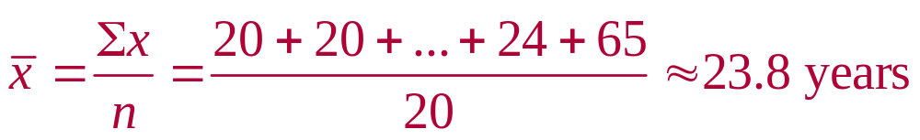
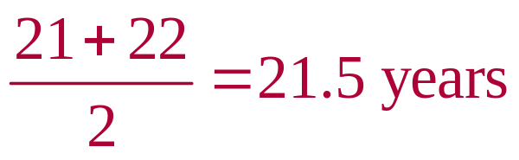
Solution: Comparing the Mean, Median, and Mode
Ages in a class
20 | 20 | 20 | 20 | 20 | 20 | 21
21 | 21 | 21 | 22 | 22 | 22 | 23
23 | 23 | 23 | 24 | 24 | 65
Mean:
Median:
Mode:
20 years (the entry occurring with the
greatest frequency)
© 2012 Pearson Education, Inc. All rights reserved.
<number> of 149

Slide 22
Solution: Comparing the Mean, Median, and Mode
Mean ≈ 23.8 years Median = 21.5 years Mode = 20 years
The mean takes every entry into account, but is influenced by the outlier of 65.
The median also takes every entry into account, and it is not affected by the outlier.
In this case the mode exists, but it doesn't appear to represent a typical entry.
© 2012 Pearson Education, Inc. All rights reserved.
<number> of 149

Slide 23
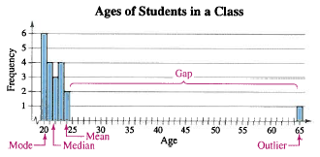
Solution: Comparing the Mean, Median, and Mode
Sometimes a graphical comparison can help you decide which measure of central tendency best represents a data set.
In this case, it appears that the median best describes the data set.
© 2012 Pearson Education, Inc. All rights reserved.
<number> of 149

Slide 24
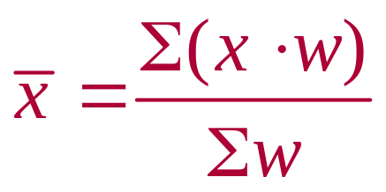
Weighted Mean
Weighted Mean
The mean of a data set whose entries have varying weights.
where w is the weight of each entry x
© 2012 Pearson Education, Inc. All rights reserved.
<number> of 149

Slide 25
Example: Finding a Weighted Mean
You are taking a class in which your grade is determined from five sources: 50% from your test mean, 15% from your midterm, 20% from your final exam, 10% from your computer lab work, and 5% from your homework. Your scores are 86 (test mean), 96 (midterm), 82 (final exam), 98 (computer lab), and 100 (homework). What is the weighted mean of your scores? If the minimum average for an A is 90, did you get an A?
© 2012 Pearson Education, Inc. All rights reserved.
<number> of 149

Slide 26
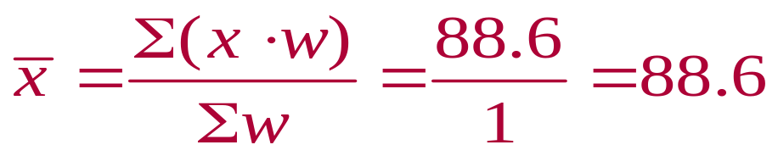
Solution: Finding a Weighted Mean
Source | Score, x | Weight, w | x∙w
Test Mean | 86 | 0.50 | 86(0.50)= 43.0
Midterm | 96 | 0.15 | 96(0.15) = 14.4
Final Exam | 82 | 0.20 | 82(0.20) = 16.4
Computer Lab | 98 | 0.10 | 98(0.10) = 9.8
Homework | 100 | 0.05 | 100(0.05) = 5.0
 |  | Σw = 1 | Σ(x∙w) = 88.6
Your weighted mean for the course is 88.6. You did not get an A.
© 2012 Pearson Education, Inc. All rights reserved.
<number> of 149

Slide 27
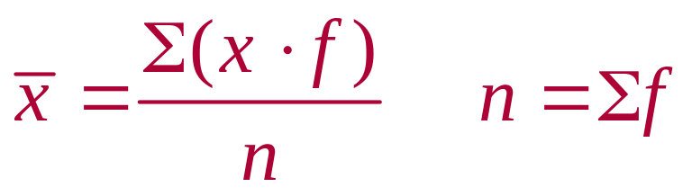
Mean of Grouped Data
Mean of a Frequency Distribution
Approximated by
where x and f are the midpoints and frequencies of a class, respectively
© 2012 Pearson Education, Inc. All rights reserved.
<number> of 149

Slide 28
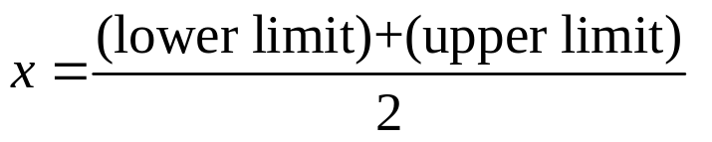

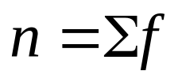
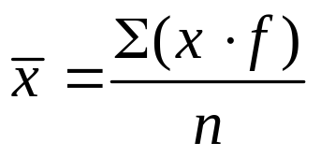
Finding the Mean of a Frequency Distribution
In Words In Symbols
Find the midpoint of each class.
Find the sum of the products of the midpoints and the frequencies.
Find the sum of the frequencies.
Find the mean of the frequency distribution.
© 2012 Pearson Education, Inc. All rights reserved.
<number> of 149

Slide 29
Example: Find the Mean of a Frequency Distribution
Use the frequency distribution to approximate the mean number of minutes that a sample of Internet subscribers spent online during their most recent session.
Class | Midpoint | Frequency, f
7 – 18 | 12.5 | 6
19 – 30 | 24.5 | 10
31 – 42 | 36.5 | 13
43 – 54 | 48.5 | 8
55 – 66 | 60.5 | 5
67 – 78 | 72.5 | 6
79 – 90 | 84.5 | 2
© 2012 Pearson Education, Inc. All rights reserved.
<number> of 149

Slide 30
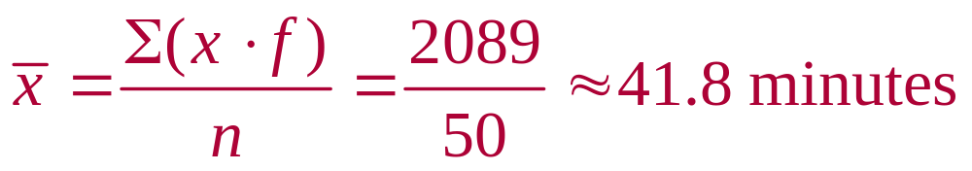
Solution: Find the Mean of a Frequency Distribution
Class | Midpoint, x | Frequency, f | (x∙f)
7 – 18 | 12.5 | 6 | 12.5∙6 = 75.0
19 – 30 | 24.5 | 10 | 24.5∙10 = 245.0
31 – 42 | 36.5 | 13 | 36.5∙13 = 474.5
43 – 54 | 48.5 | 8 | 48.5∙8 = 388.0
55 – 66 | 60.5 | 5 | 60.5∙5 = 302.5
67 – 78 | 72.5 | 6 | 72.5∙6 = 435.0
79 – 90 | 84.5 | 2 | 84.5∙2 = 169.0
 |  | n = 50 | Σ(x∙f) = 2089.0
© 2012 Pearson Education, Inc. All rights reserved.
<number> of 149

Slide 31
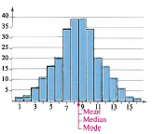
The Shape of Distributions
Symmetric Distribution
A vertical line can be drawn through the middle of a graph of the distribution and the resulting halves are approximately mirror images.
© 2012 Pearson Education, Inc. All rights reserved.
<number> of 149

Slide 32
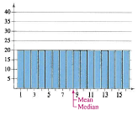
The Shape of Distributions
Uniform Distribution (rectangular)
All entries or classes in the distribution have equal or approximately equal frequencies.
Symmetric.
© 2012 Pearson Education, Inc. All rights reserved.
<number> of 149

Slide 33
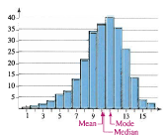
The Shape of Distributions
Skewed Left Distribution (negatively skewed)
The “tail” of the graph elongates more to the left.
The mean is to the left of the median.
© 2012 Pearson Education, Inc. All rights reserved.
<number> of 149

Slide 34
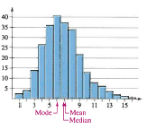
The Shape of Distributions
Skewed Right Distribution (positively skewed)
The “tail” of the graph elongates more to the right.
The mean is to the right of the median.
© 2012 Pearson Education, Inc. All rights reserved.
<number> of 149

Slide 35
Section 2.3 Summary
Determined the mean, median, and mode of a population and of a sample
Determined the weighted mean of a data set and the mean of a frequency distribution
Described the shape of a distribution as symmetric, uniform, or skewed and compared the mean and median for each
© 2012 Pearson Education, Inc. All rights reserved.
<number> of 149

